Slide 1

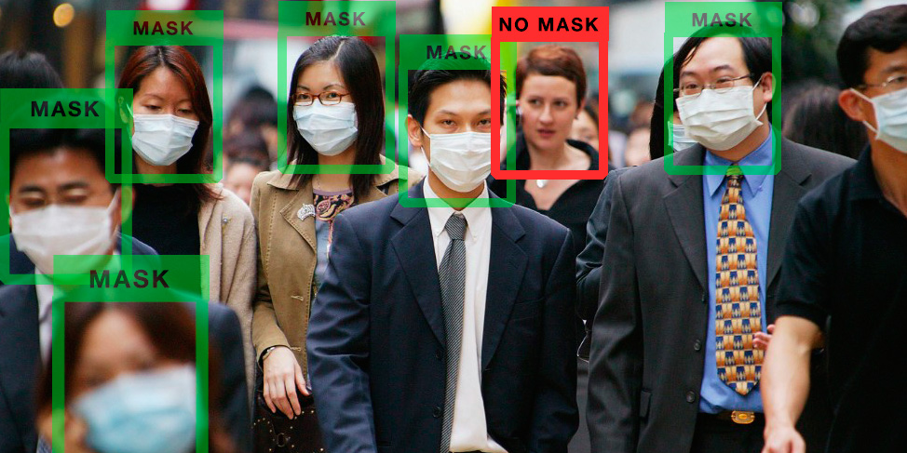
FACE MASK DETECTION USING ARTIFICIAL INTELLIGENCE TO
OPERATE AUTOMATIC DOOR
GROUP: JIGGLYPUFF
TEAM MEMBERS:
SUHAILA : 1910496
FAHIM AHMED : 2022409
MOHAMMED AZWAD SADAT : 1910902

Slide 2
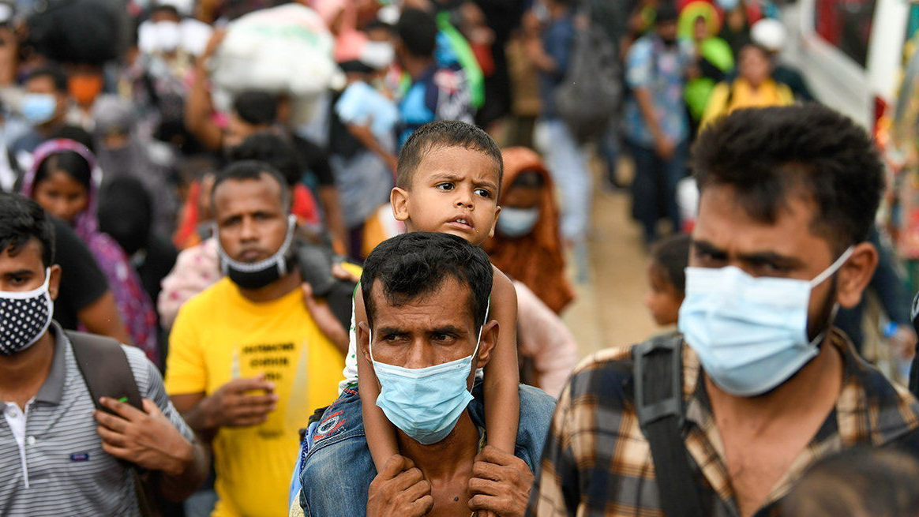
INTRODUCTION
Only 64% Bangladeshi urban dwellers wears mask.
About 75% reduction in transmission of COVID-19 if masks are worn.
Difficult to make wearing mask a habit.
Fail to enforce mask wearing.
Creates unsafe environment.

Slide 3
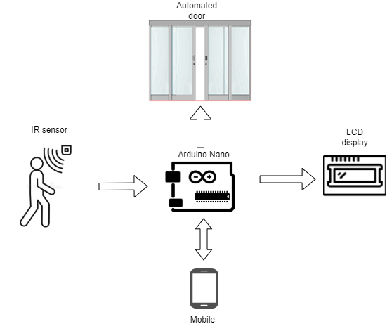
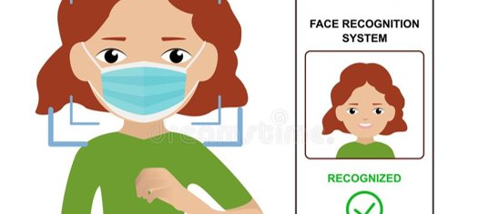
PROPOSED SYSTEM

Slide 4
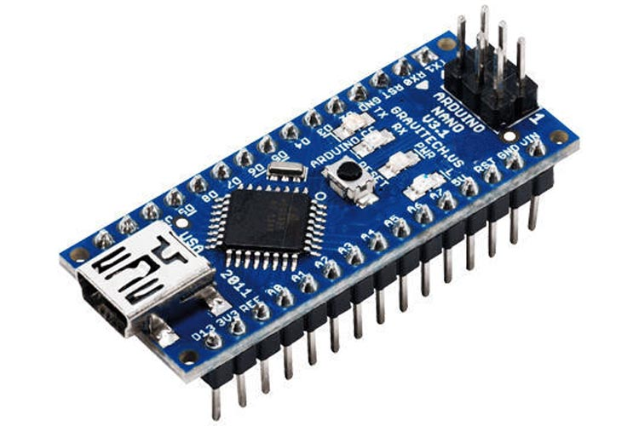
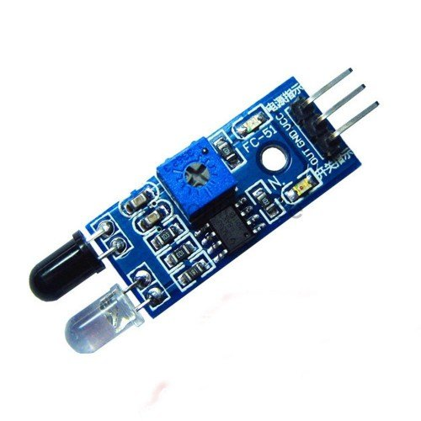

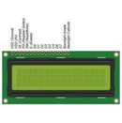
COMPONENTS
Arduino Nano
IR sensor
LEDs
LCD display (16x2)

Slide 5
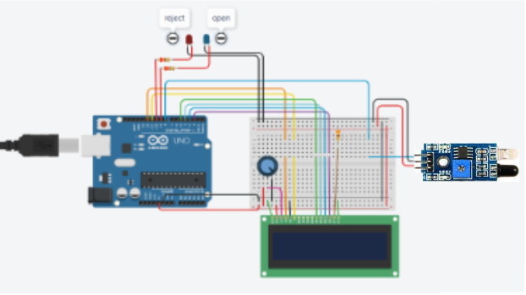
CIRCUIT ANALYSIS

Slide 6

LIVE DEMO

Slide 7
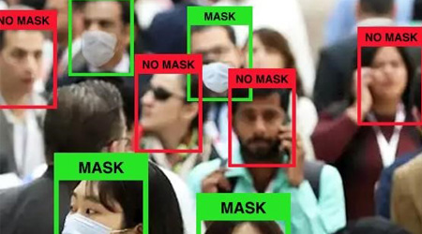
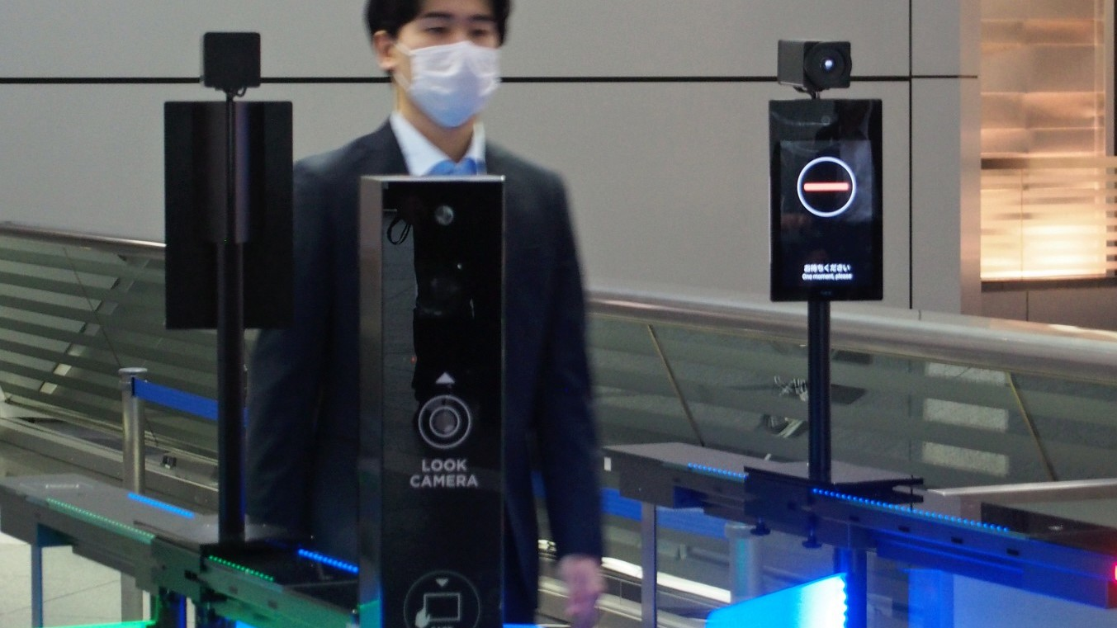
DRAWBACKS
AI can only handle a limited number of situations.
Old phones may not be able to handle running the system.

Slide 8

FUTURE SCOPE
Train the AI model with bigger dataset.
Introduce more classification classes to AI.
System can used to determine % of mask wearers.
Statistics can be sent to authorities via IoT.

Slide 9

CONCLUSION
Reduces risk of spreading the COVID-19.
Help create the habit of mask-wearing among the masses.
Ensure a safe environment.
System is eco-friendly and cheap.

Slide 10
THANK YOU!

